Slide 1
For PF Study

Slide 2
Rami
Trunks
Divisions:
Anterior
Posterior
Cords
Branches
C5
C6
C7
C8
T1
Superior
Lateral
Musculocutaneous n.
Middle
Posterior
Radial n.
Median n.
Axillary n.
Inferior
Medial
Ulnar n.

Slide 3
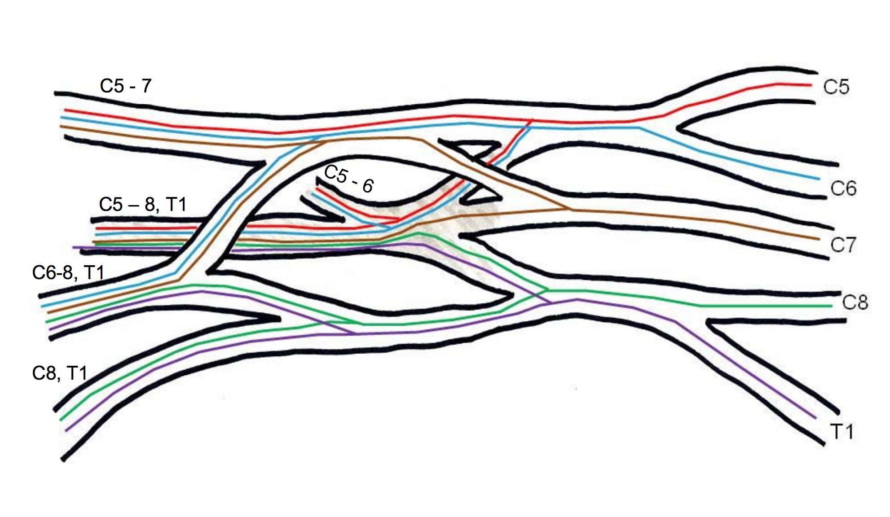
C5
C6
C7
C8
T1

Slide 4
Rami
Trunks
Divisions:
Anterior
Posterior
Cords
Branches
C5
C6
C7
C8
T1
Musculocutaneous n.
(C5-C7)
Superior
Lateral
Radial n.
(C5-T1)
Median n.
(C5-T1)
Middle
Posterior
Axillary n.
(C5-C6)
Ulnar n.
(C8-T1)
Inferior
Medial

Slide 5
Compartmental Innervation of the Brachial Plexus
Axillary nerve: Deltoid & teres minor mm.
Radial nerve: Posterior compartment of arm & forearm; posterior hand
Musculocutaneous nerve: Anterior compartment of arm
Median nerve: Anterior compartment of forearm; thenar muscles
Ulnar nerve: Anterior compartment of forearm; hypothenar muscles
Note: We will discuss more specific muscular innervations & dermatome innervation in the next lecture.

